Slide 1




NEXT.JS_NEWS WEBSITE
FS’tival-22 Software Freedom Day
Presented by:
TEAM ENCODERS
Daniel Inigo M (20C016)
Siva Guhan S (20C083)
Udaya Priya K (20C097)

Slide 2
Problem Statement
There are multiple news sharing apps used by a single user and are often spammed with notifications which cause users to miss important events across the globe.
A news-sharing app wants to help users find relevant and important news easily every day.
It is tough and time-consuming to get news from several applications or websites especially in India, where Unity meets Diversity. Moreover, getting brief and customised news of your interest is considerably more difficult.
People don't have enough time to read all of the news as the times change.
Some people might prefer focus on news that interests them, such as business, sports, or entertainment, while others would have completely other interests.

Slide 3
Objective
To develop a web portal where people can get to know the latest news around the world.
Title, a short summary and a picture relevant to a particular breaking news story will be displayed to the user.
When the user clicks on the title of the news, it must redirect to the news article.
User must be able to see news related to the country of their choice.
News must be categorised as General, Business, Entertainment, Health, Science, Technology and Sports.

Slide 4




Tech Stack
FRONTEND
NEXTJS
Open-source web development framework created by Vercel enabling React-based
web applications with server-side rendering and generating static websites.
TAILWIND
Utility-first CSS framework for rapidly building custom user interfaces
NEWS API
Simple HTTP REST API for searching and retrieving live articles from all over the web.
The webpage is designed using Next.js and Tailwind CSS.
Tailwind CSS is used to style the website in a much more interactive and at the same time in a quite simple manner.

Slide 5
Modules
HOME PAGE
On the click of the home icon,home icon is displayed which allows the user to select the country of their choice from the dropdown menu in list form.
In the Navbar, categories of news are provided to the user to make it easier and quick to search for their news of interest.
On clicking the button Display News Feed, it is directed to the page containing latest news related to the selected country and displays it.

Slide 6
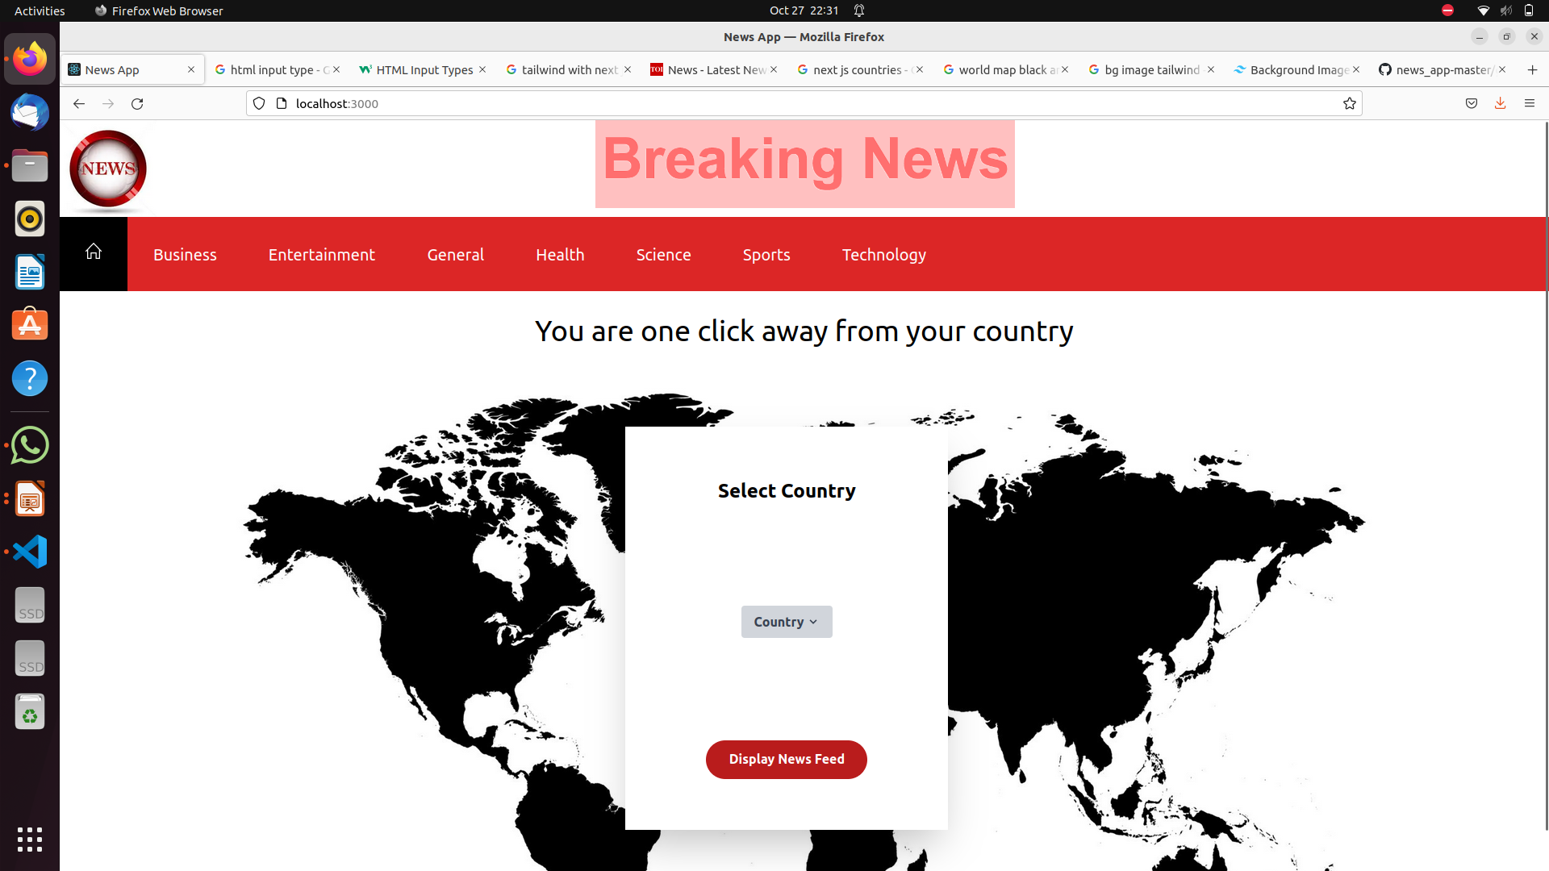
Modules

Slide 7
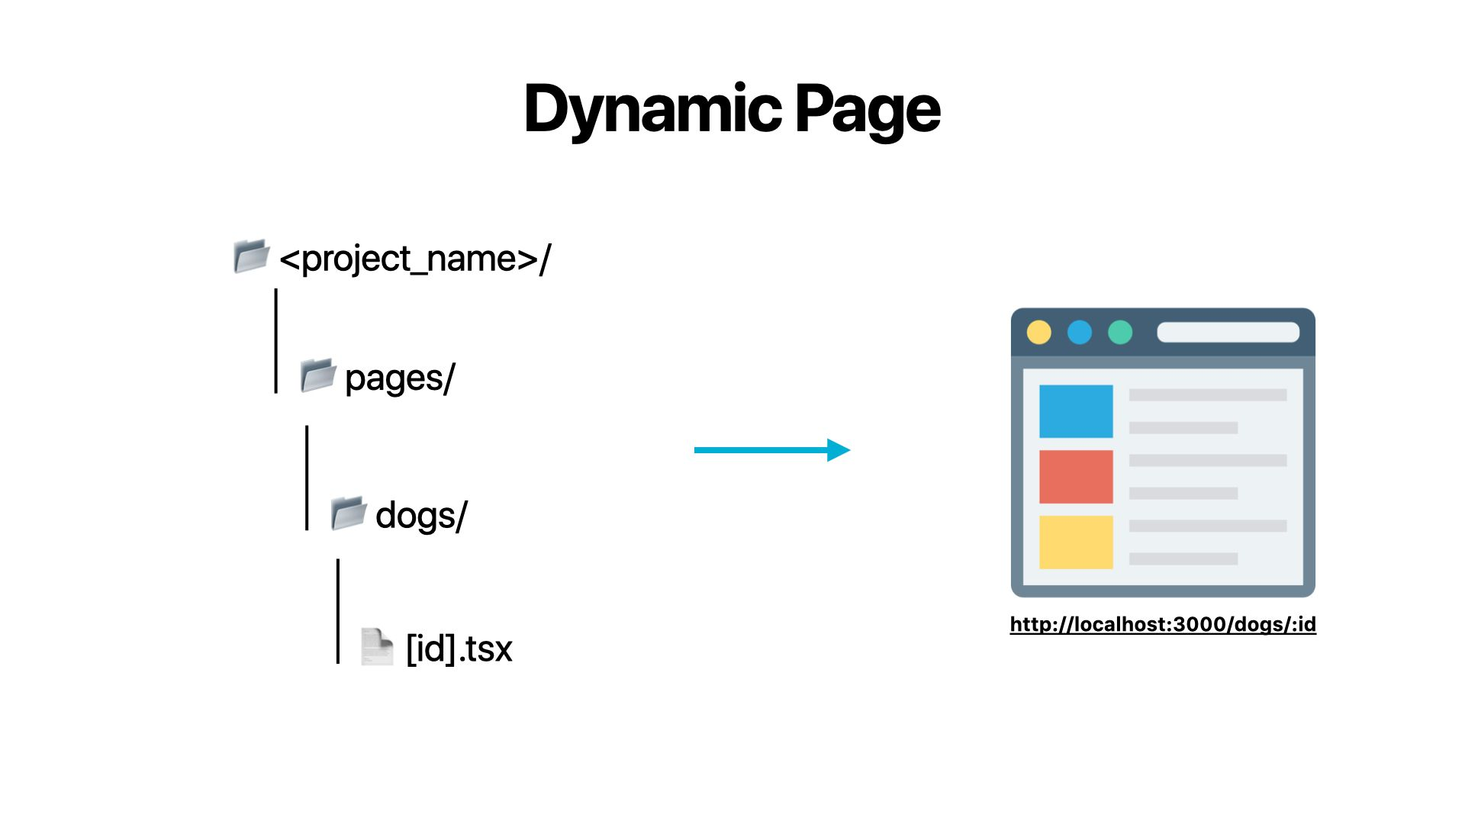
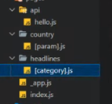
Modules
NEWS PAGE ACCORDING TO THE COUNTRY SELECTED (INDIA)
The news about the desired country chosen by the user is fetched from the NEWS API.
In code [param].js is used to exhibit dynamic routing, where the country is passed as prop.

Slide 8
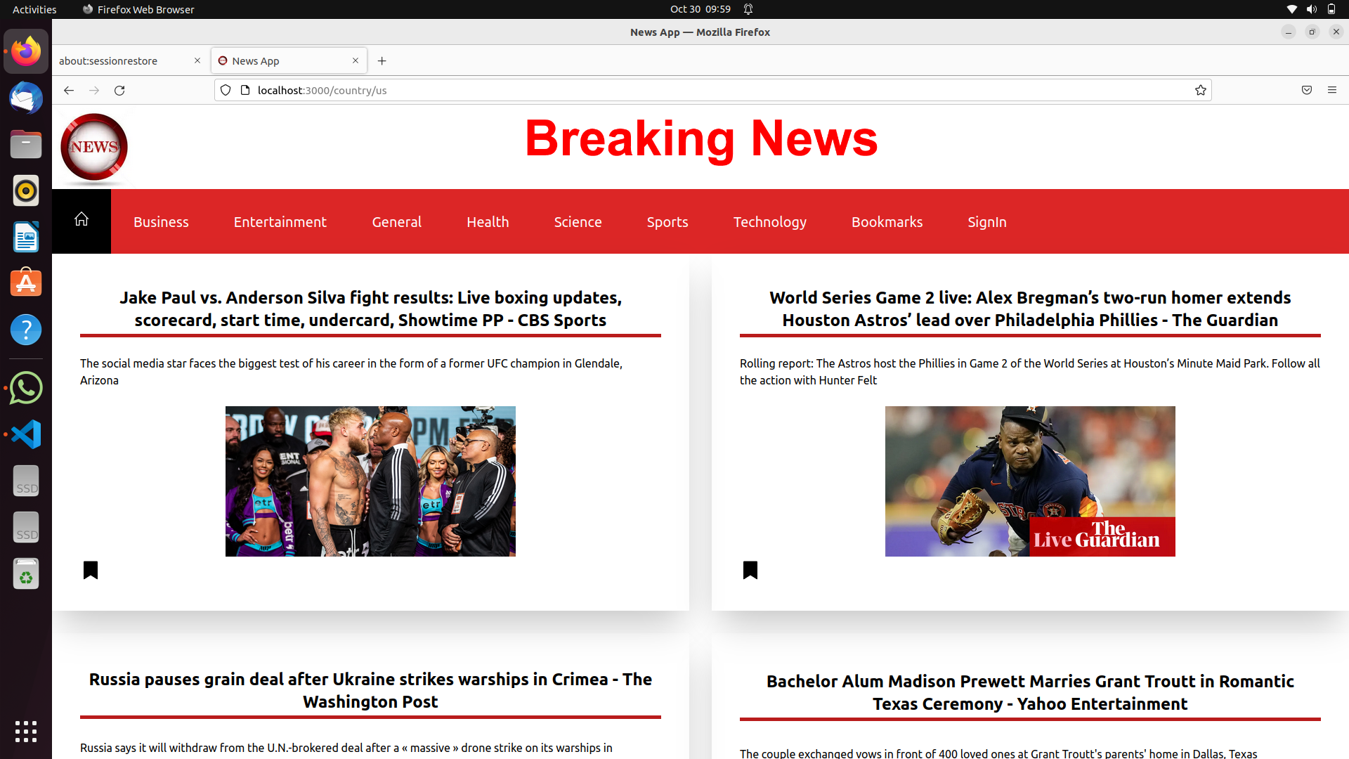
Modules

Slide 9
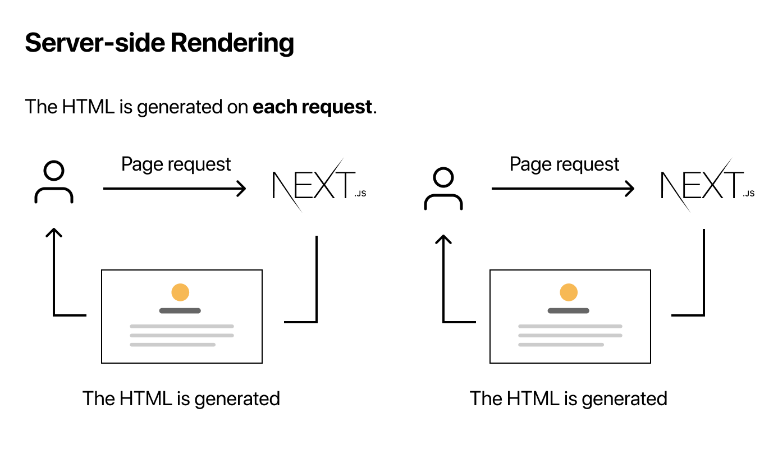
Modules
NEWS PAGE ACCORDING TO THE CATEGORY OF NEWS SELECTED
When user selects their category of interest in the news website, the getServerSideProps is used to fetch the appropriate response i.e the news from the API and displays it to the user. The Server side rendering property of Next.js is utilised here.
In code [category].js is used to achieve dynamic routing, a special feature of Next.js.

Slide 10
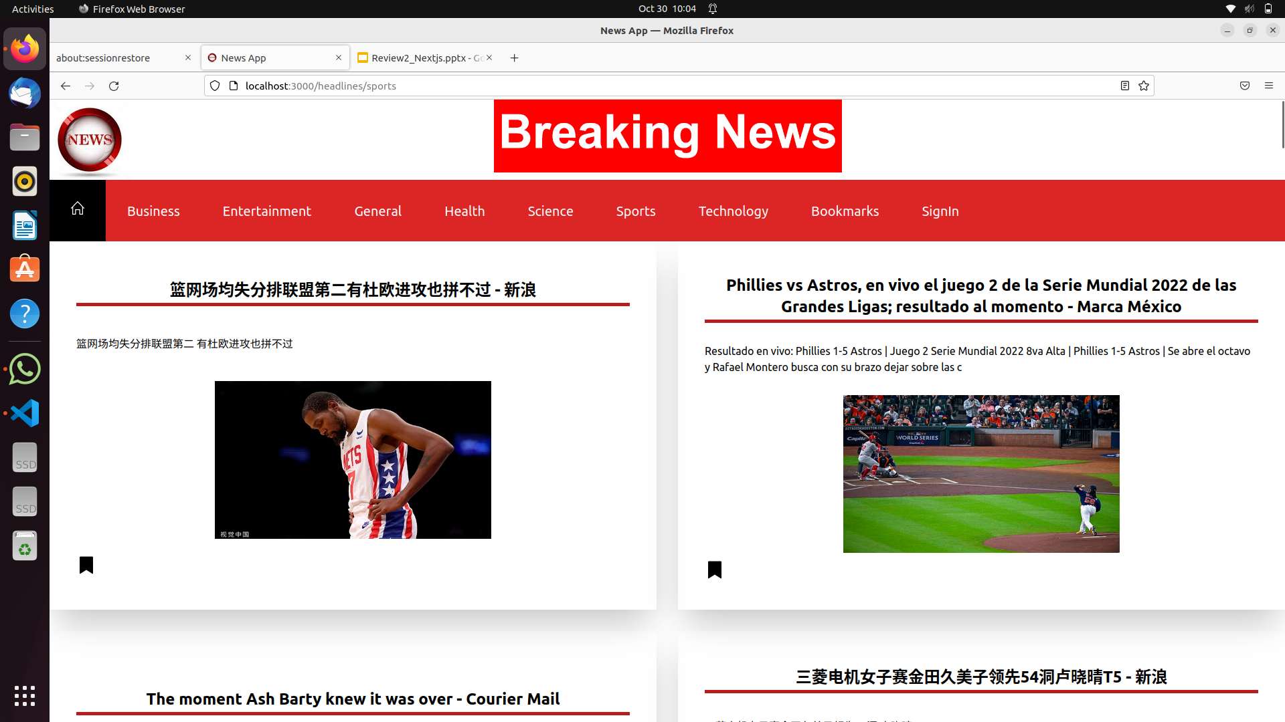
Modules

Slide 11
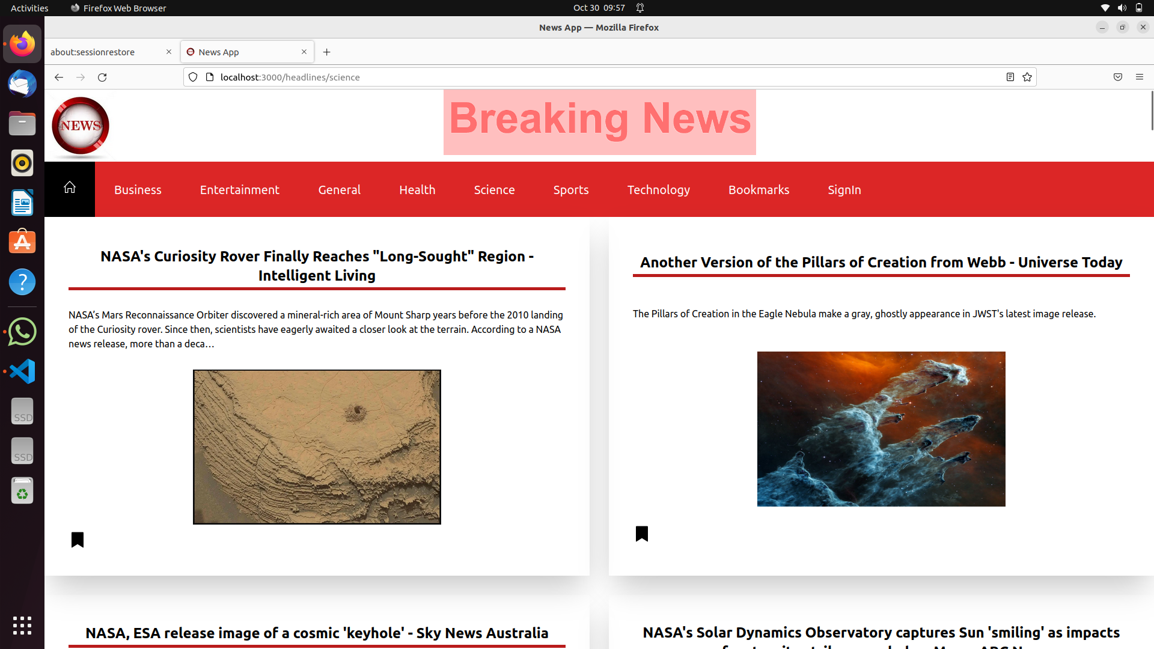
Modules

Slide 12
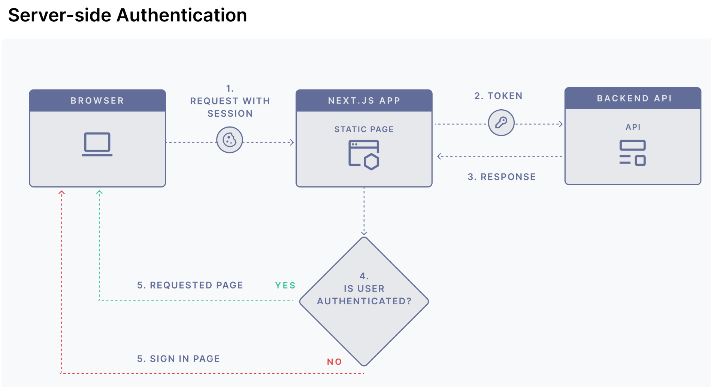
Modules
SIGN IN AND SIGN OUT
The authentication process in Next.js is also implemented by allowing the users to Sign In with their Google account using server - side authentication.
Once they have successfully signed in, users are provided with the feature to bookmark the news which they find interesting or wish to save for later use.
Finally they can Sign Out but once signed out, users cannot see the bookmarked news

Slide 13
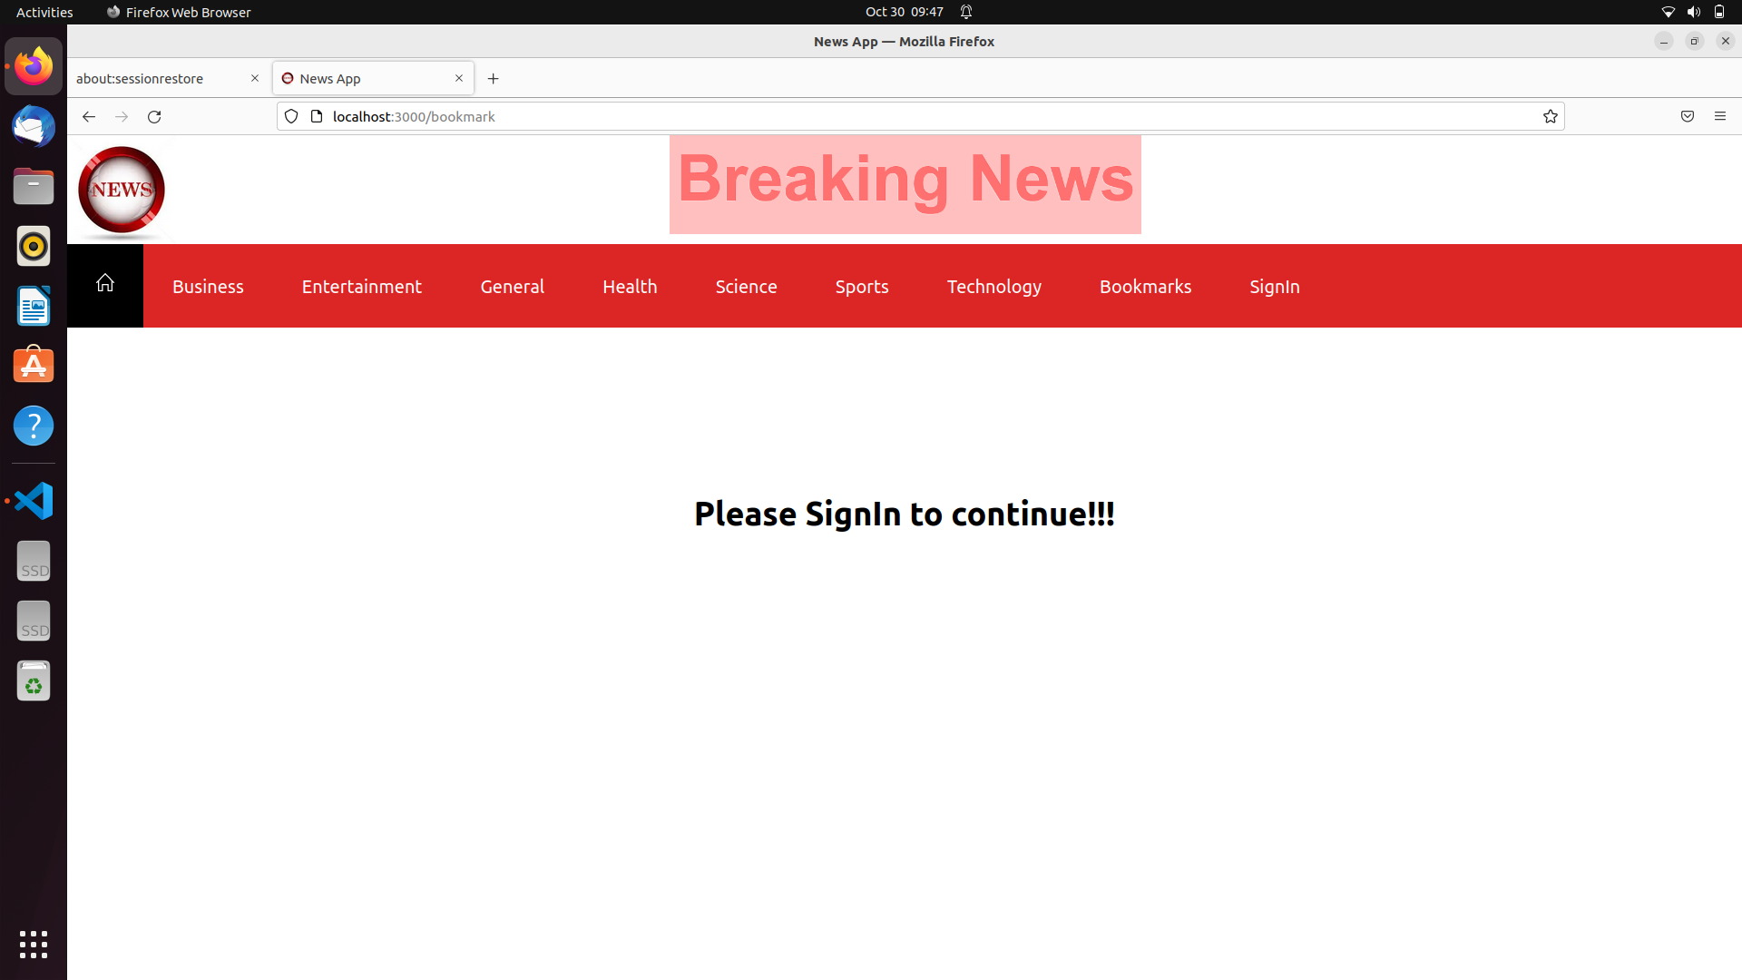
Modules

Slide 14
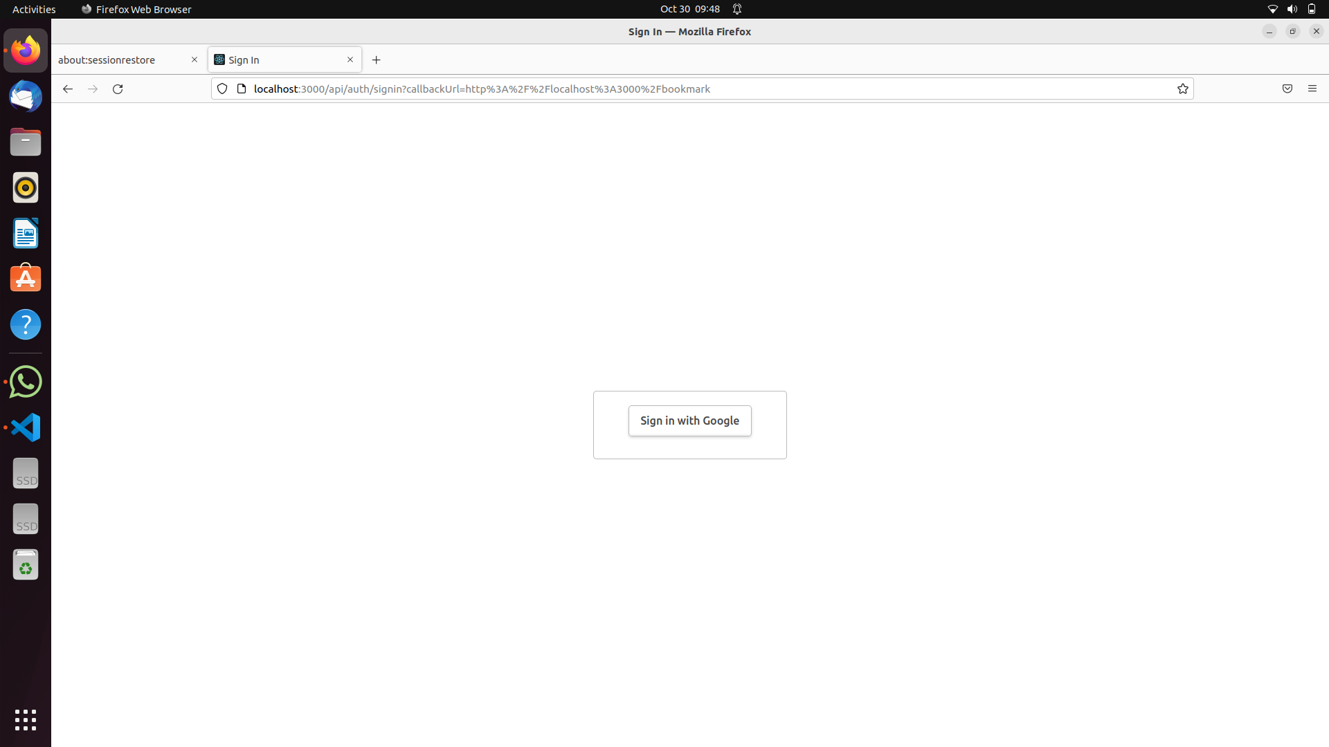
Modules

Slide 15
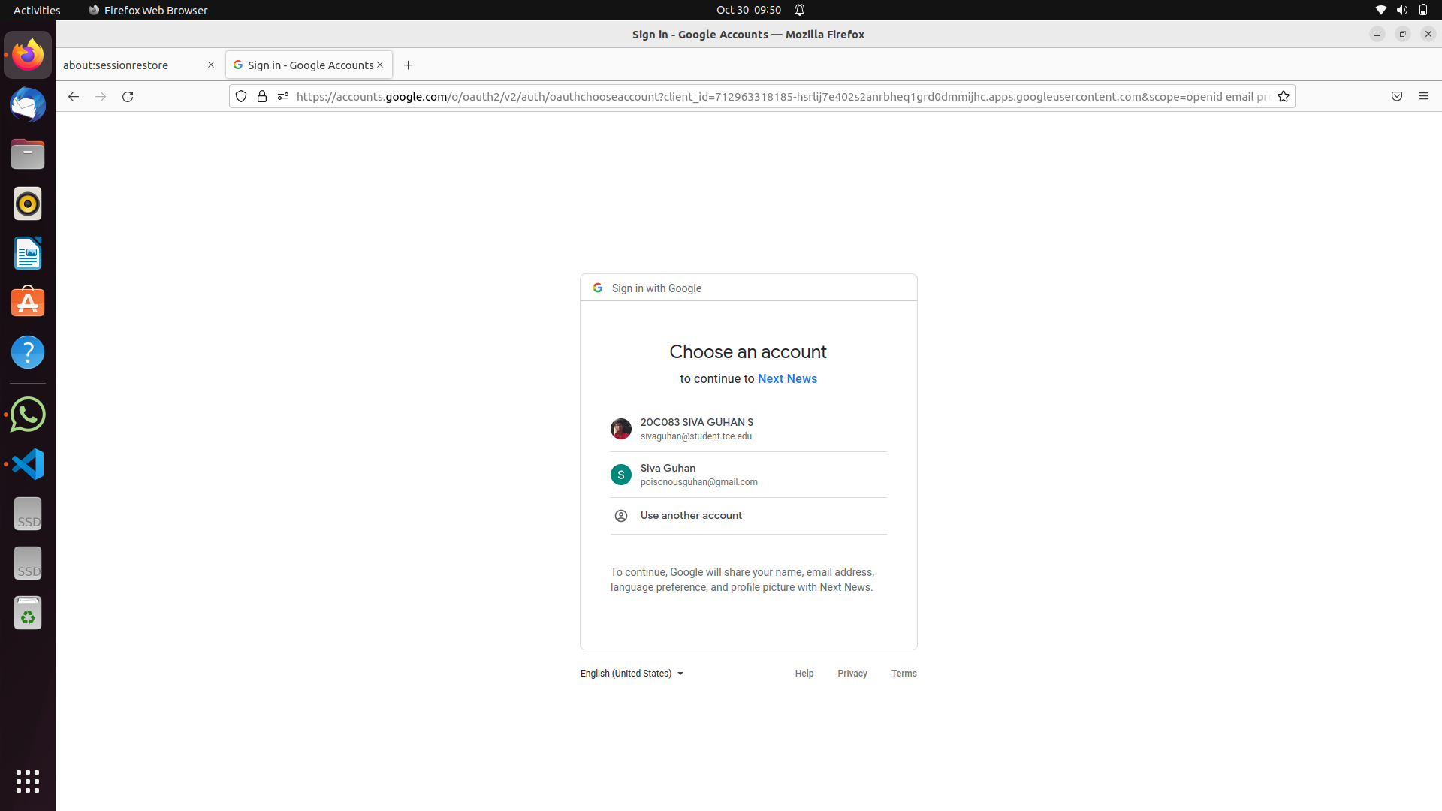
Modules

Slide 16
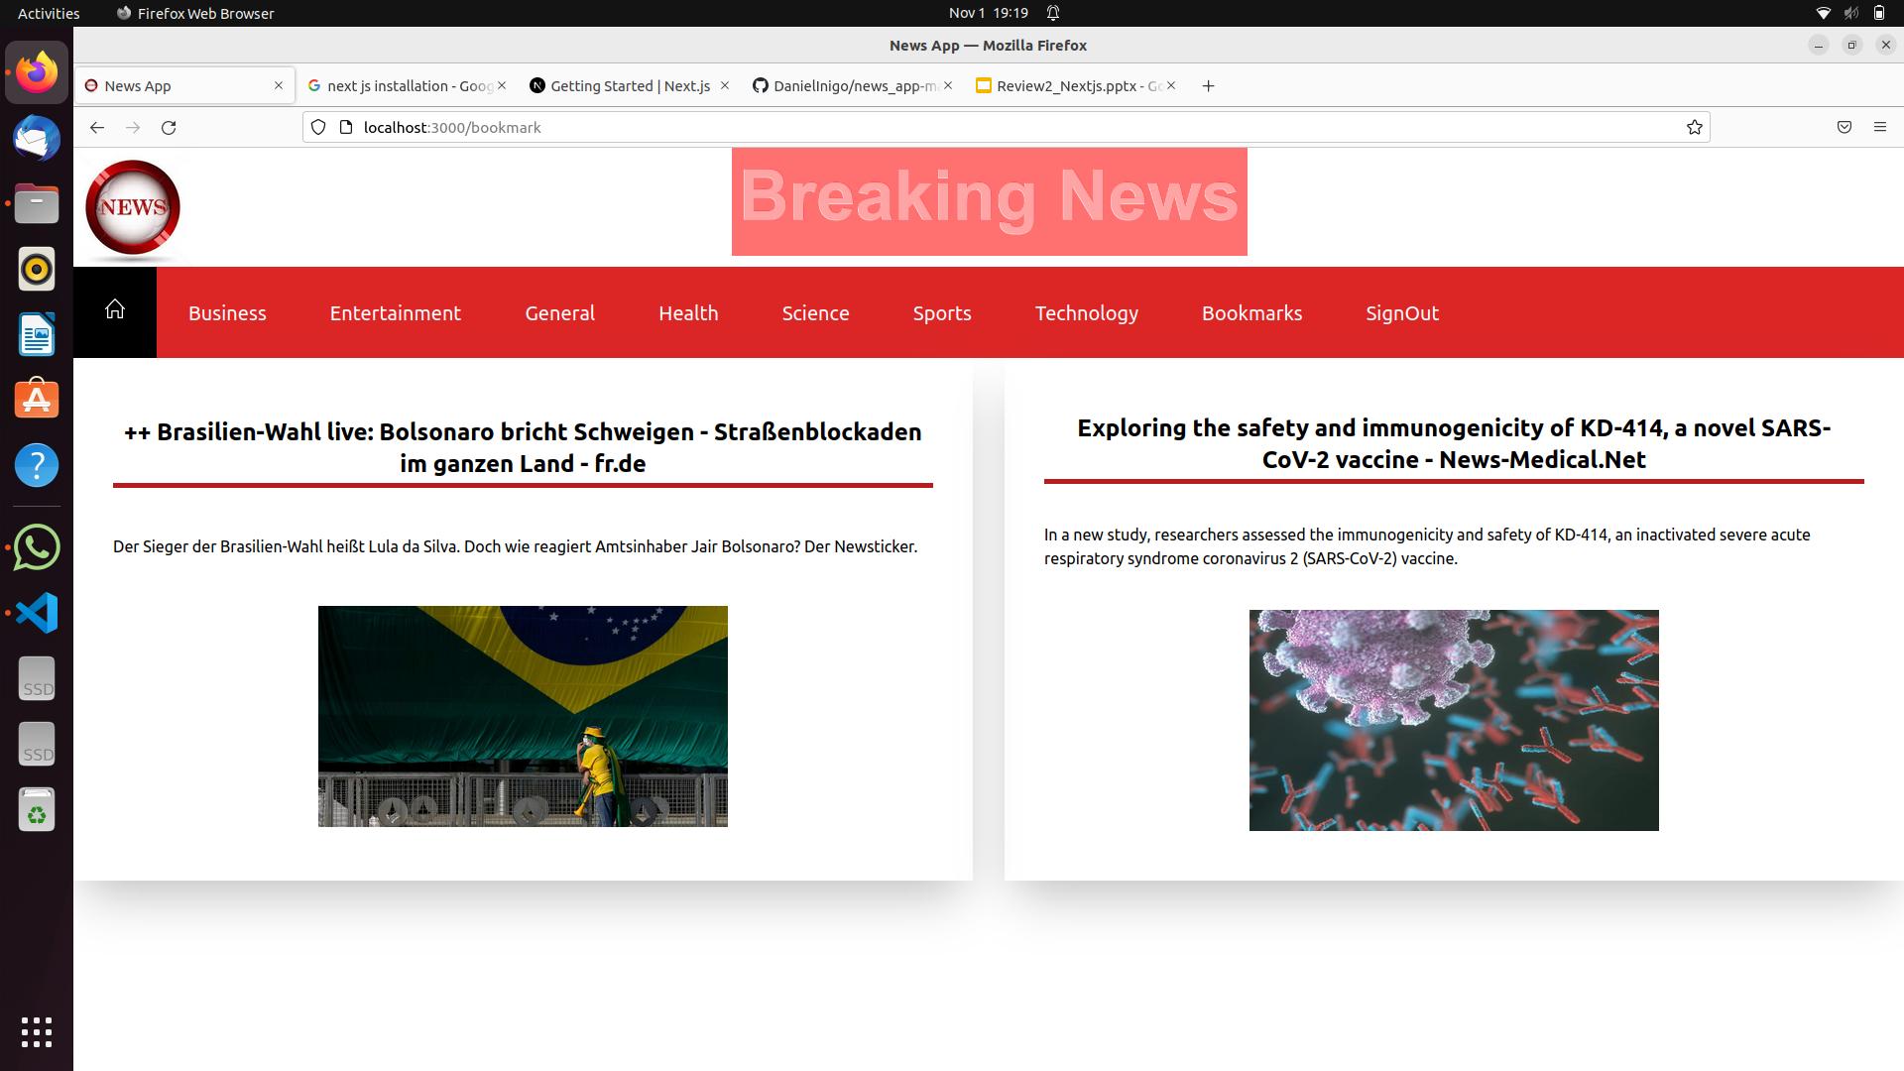
Modules

Slide 17
GIT LINK
Git link : https://github.com/DanielInigo/news_app-master

Slide 18
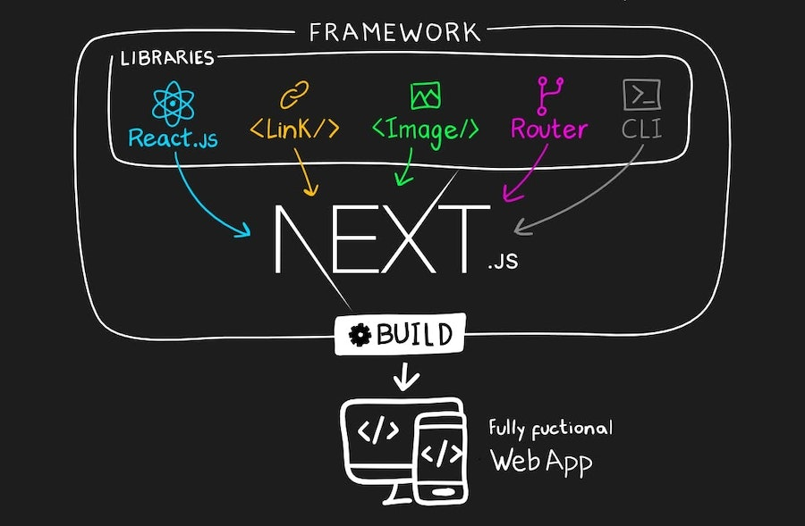
Thank You

